Slide 1
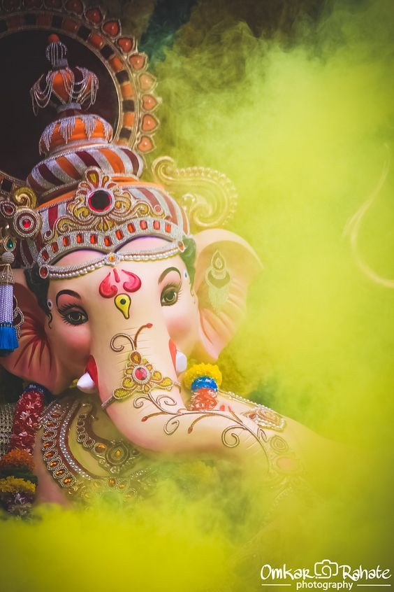
Ganpati
Festival
By
Pawan Mahadu Sarule
Class: FYBCA(Sci)

Slide 2

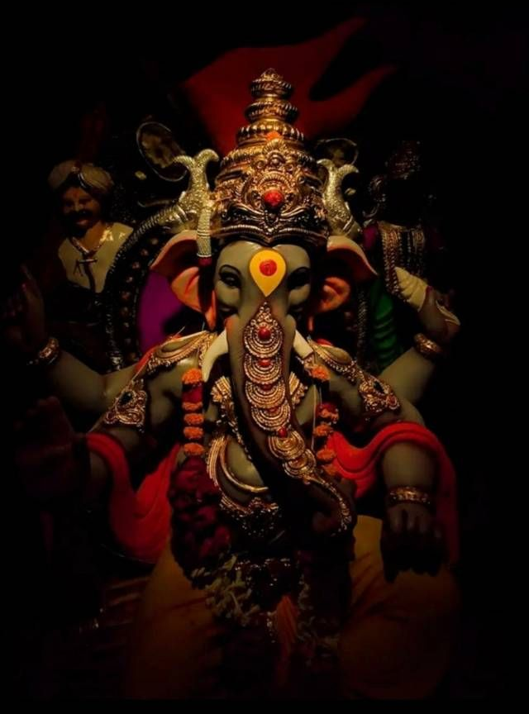
Introduction
Hindu festival celebrated on the occasion of birthday of Lord Ganesha
Bestows his presence on earth for all his devotees
Widely worshipped as the God of wisdom, prosperity and good fortune
Traditionally invoked at the beginning of any new venture.
Lord Ganesh is remembered on Ganesh Chaturthi which falls on the fourth day of the month of Bhadrapad in the Hindu calendar.
Ganesh Chaturthi is a ten-day celebration.

Slide 3

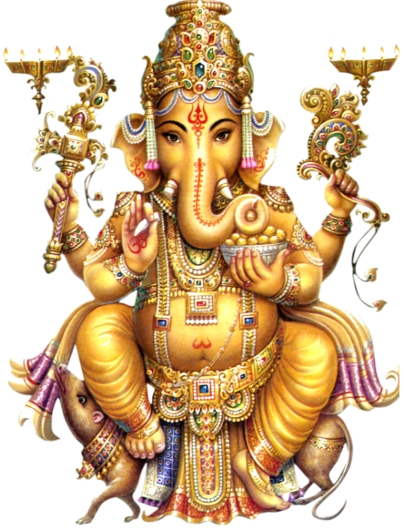
History
Ganesh Chaturthi was being celebrated as a public event by Peshvas in Pune since the times of Shivaji Maharaj.
With the fall of the Peshwas, Ganesh Chaturthi lost state patronage and became aprivate family celebration.
Indian freedom fighter and social reformer Lokmanya Tilak introduced a new way of celebrating the Ganapati festival ascollective community worship.

Slide 4

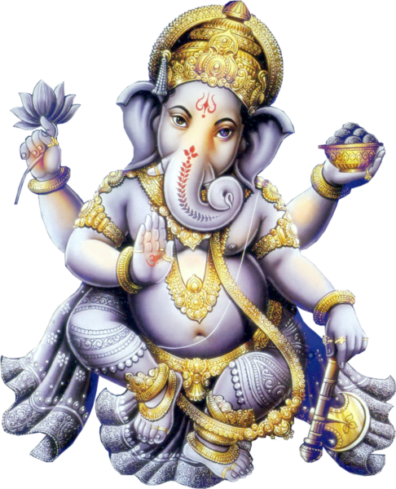
Date
observed in the Hindu calendar in the month of Bhaadrapada.
starts on the Shukla Chaturthi
falls between 19 August and 15 September.
But this year it is on 19th September.
lasts for 10 days.
ends on Anant Chaturdashi.

Slide 5

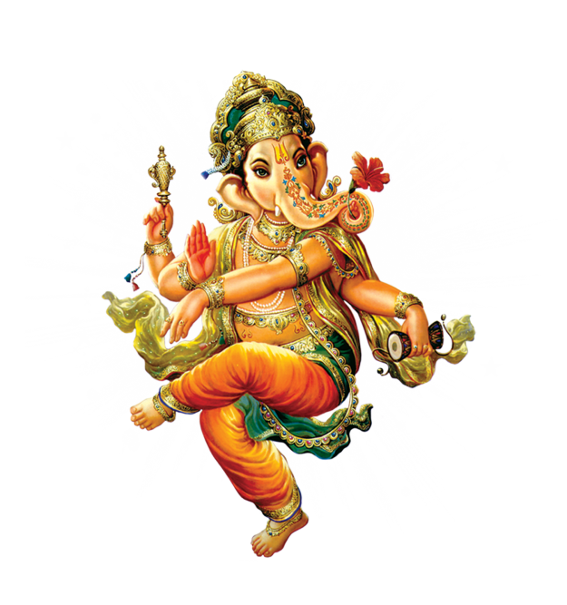
Place
All over India, mainly in Maharashtra, Andhra Pradesh, Karnataka and Goa.
Outside India: Nepal, UK, US, Canada, Mauritius, France, Singapore, Thailand, Cambodia, Burma, and Fiji.
UK: First time in the Vishwa Hindu Temple in 2005,
Mauritius: Celebration started here in 1896 by well known Bhiwajee family So popular that the Mauritian government proclaimed Ganesh Chaturthi day as a public holiday.

Slide 6

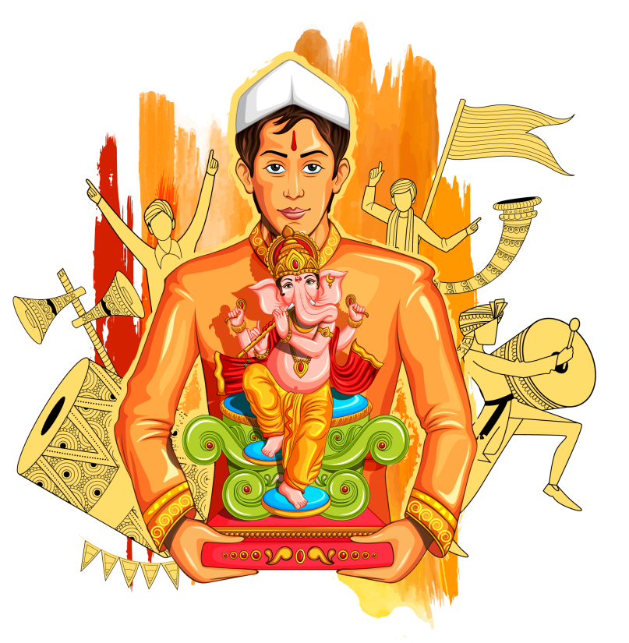
Celebrate
Ganesh idol is brought & ceremoniously installed by the head of the house hold in the "home mandir“.
Decorated with rangoli.
"Puja" and "aarti" are performed every morning andevening.
Modak as prasaad is distributed amongst the devotees
Notes:
at Home

Slide 7

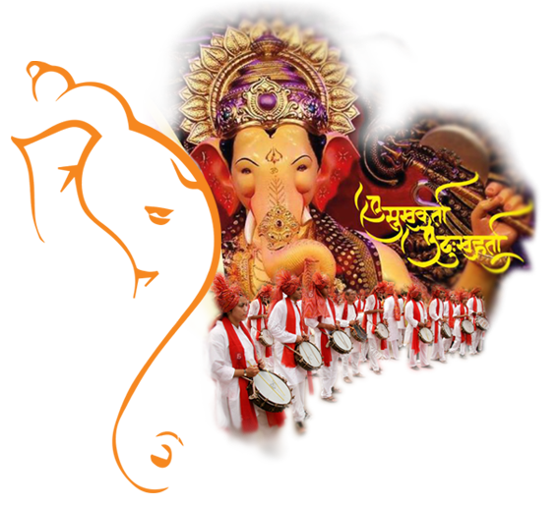
Thank
You

